Slide 2
File system to DBMS
Problems existed in Traditional File system
Redundancy of data
Inconsistency of Data
Difficult Data Access
Unauthorized Access
No Concurrent Access
No Backup and Recovery

Slide 3
Data Models
Data models define how the logical structure of a database is modeled.
Data Models are fundamental entities to introduce abstraction in a DBMS. Data models define how data is connected to each other and how they are processed and stored inside the system

Slide 4
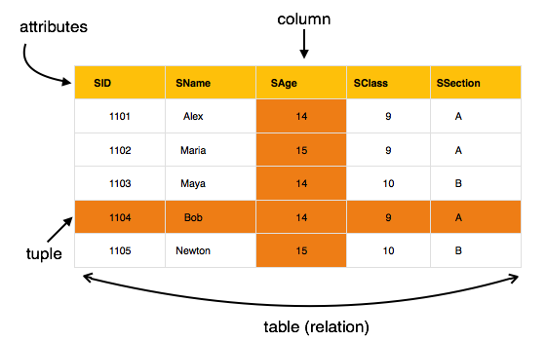
Relational Model
In relational model, the data and relationships are represented by collection of inter-related tables. Each table is a group of column and rows, where column represents attribute of an entity and rows represents records.

Slide 5
Entity-Relationship Model
Entity-Relationship (ER) Model is based on the notion of real-world entities and relationships among them. While formulating real-world scenario into the database model, the ER Model creates entity set, relationship set, general attributes and constraints.
ER Model is best used for the conceptual design of a database.
ER Model is based on −
Entities and their attributes.
Relationships among entities.

Slide 6
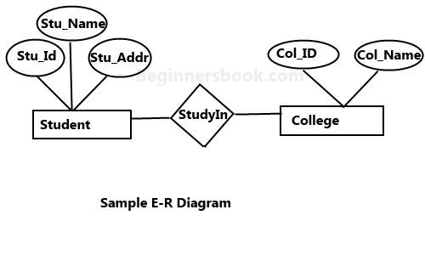

Slide 7
Hierarchical Model
Data is organized into a tree like structure with each record is having one parent record and many children. The main drawback of this model is that, it can have only one to many relationships between nodes.

Slide 8
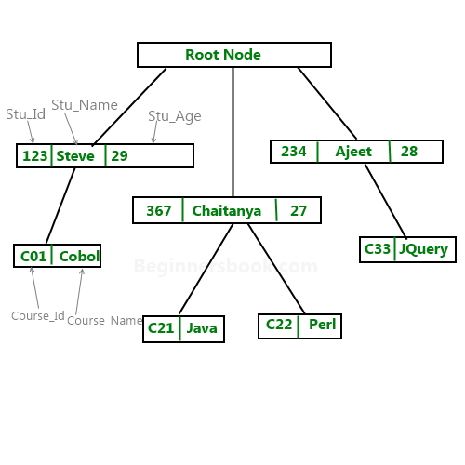

Slide 9
Network and Object Oriented Model
Network Model – Network Model is same as hierarchical model except that it has graph-like structure rather than a tree-based structure. Unlike hierarchical model, this model allows each record to have more than one parent record.
Object Oriented Model- Object oriented data model is based upon real world situations. These situations are represented as objects, with different attributes. All these object have multiple relationships between them.

Slide 10
Database Schema v/s Instance
SCHEMA | INSTANCE
It is the overall description of the database. | It is the collection of information stored in a database at a particular moment.
Schema is same for whole database. | Data in instances can be changed using addition, deletion, updation.
Does not change Frequently. | Changes Frequently.
Defines the basic structure of the database i.e how the data will be stored in the database. | It is the set of Information stored at a particular time.

Slide 11
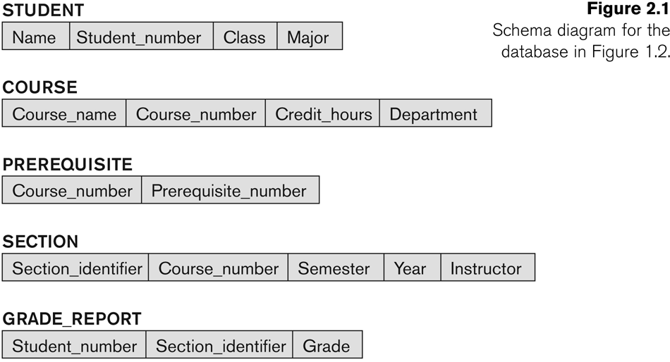
Example of Schema

Slide 12

Example of Instance

Slide 13
Types of schema
Internal/ Physical schema
Conceptual/ logical schema
External/ view schema

Slide 14
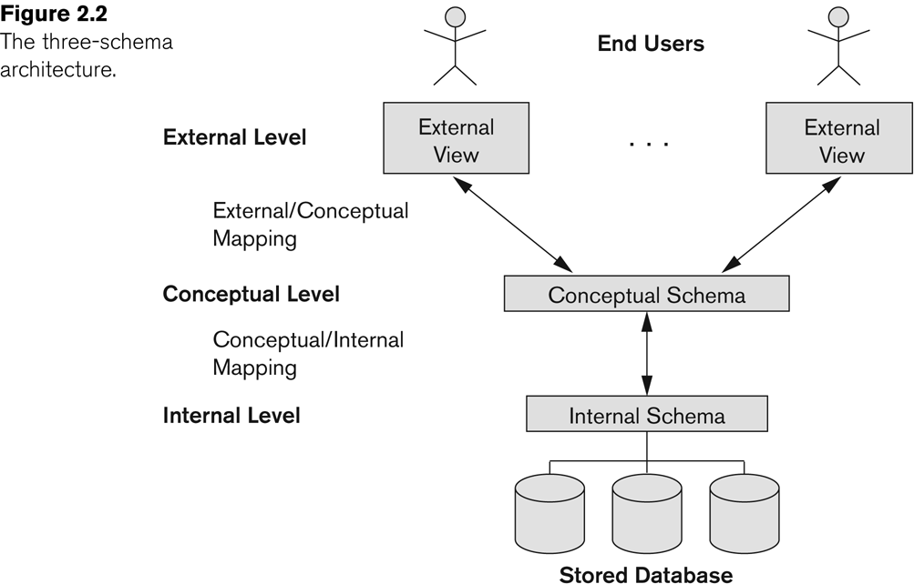
Three schema architecture

Slide 15
Physical Level: At the physical level, the information about the location of database objects in the data store is kept.
In simple terms, physical level of a database describes how the data is being stored in secondary storage devices like disks and tapes and also gives insights on additional storage details

Slide 16
Conceptual Level: At conceptual level, data is represented in the form of various database tables.
it describes what kind of data is to be stored in the database.

Slide 17
External Level: An external level specifies a view of the data in terms of conceptual level tables. Each external level view is used to cater to the needs of a particular category of users.
The main focus of external level is data abstraction.

Slide 18
Data Independence
Data independence means a change of data at lower level should not affect higher level.
Two types of data independence are present in this architecture:
1. Physical Data Independence
2. Logical Data Independence

Slide 19
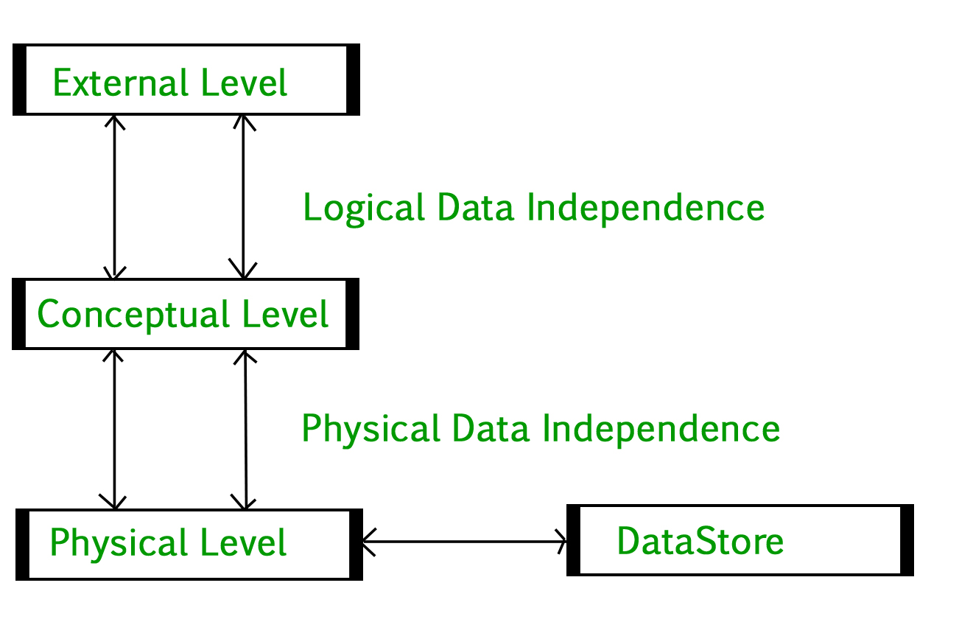
Data Independence

Slide 20
Physical data independence
Any change in the physical location of tables and indexes should not affect the conceptual level or external view of data. This data independence is easy to achieve and implemented by most of the DBMS.

Slide 21
Conceptual Data Independence:
The data at conceptual level schema and external level schema must be independent. This means a change in conceptual schema should not affect external schema.
e.g.;. Adding or deleting attributes of a table should not affect the user’s view of the table But this type of independence is difficult to achieve as compared to physical data independence because the changes in conceptual schema are reflected in the user’s view.

Slide 22
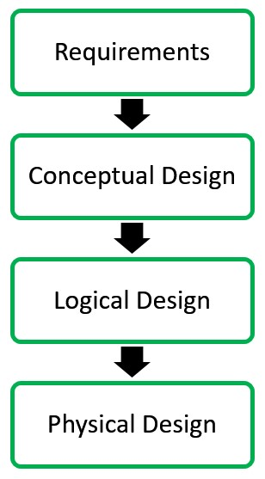
Phases of database design

